Slide 1
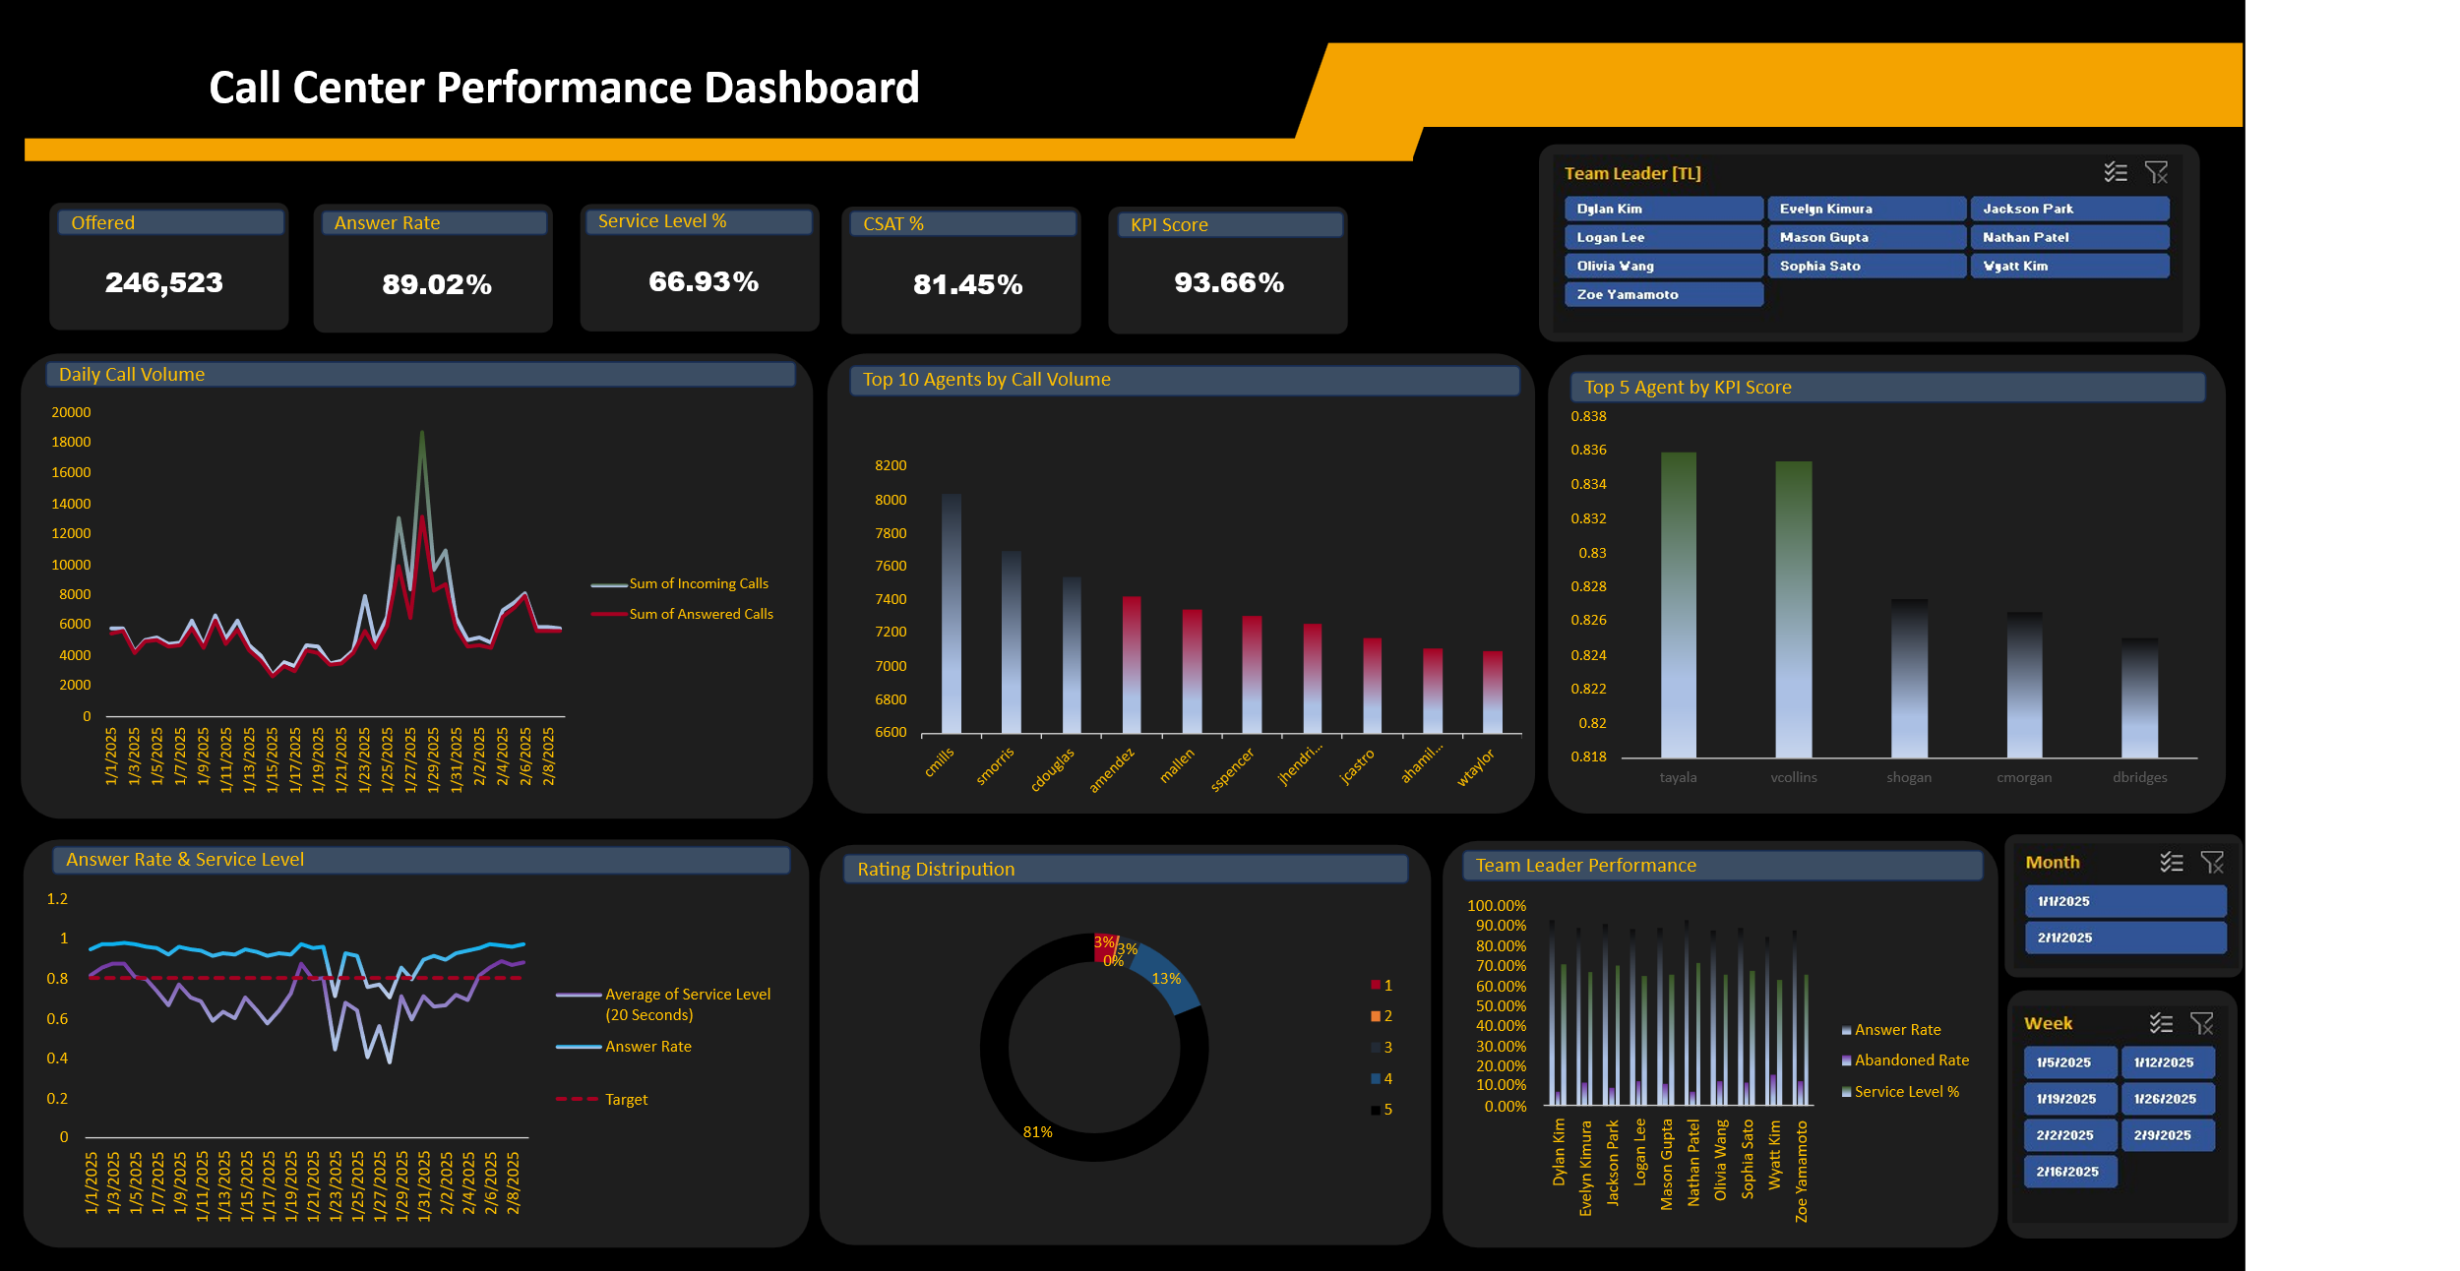

Slide 2
Key Insights & Recommendations
📞 Volume Dynamics • Total Calls: 246,523 • Daily Peak (Jan 28): 18,707 → SL: 70.4%, AR: 37.8% • Daily Low (Jan 15): 2,770 → SL: 94.3%, AR: 94.3% 📊 Service Level & Answer Rate • Avg SL: 66.93% (Target: 80%) • Avg AR: 89.02% • Notable Low: Jan 12 → SL: 58.9% • Strong Start: Jan 4 → SL: 97.9%, AR: 87.6% ⚡ Speed & Efficiency • ASA: 0.42 min (Target: 25 sec) • AHT: 4.71 min (Target: 4 min 40 sec) 👥 Agent & TL Performance • Top 5 by Volume: cmills, smorris, cdouglas, amendez, mallen • Top 5 by KPI Score: tayala, xcollins, shogan, cmorgan, dbridges • Highest AR: Dylan Kim 92.93%, Lowest SL: Wyatt Kim 62.65% 🌟 Customer Satisfaction (CSAT) • Responses: 1,148 • CSAT: 81.45% (Target: 80%)
1. 📦 Handle High Volume Spikes Overflow routing during Jan 28 spike. 2. 🧭 Optimize Mid-Month Coverage Adjust staffing for Jan 12–14 & 23–26. 3. 🚀 Improve ASA Implement fast-lane queue to reduce ASA below 20 sec. 4. 🎯 Targeted Coaching Peer-led training from top performers.

